Slide 1
Control

Slide 2
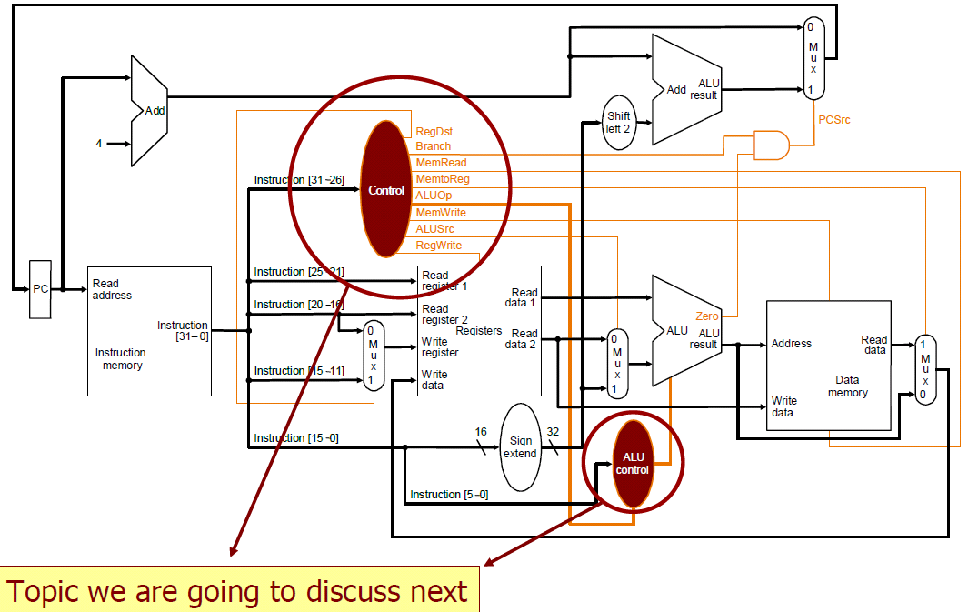
Datapath + Control Unit

Slide 3
Control Unit
Datapath control unit controls the whole operation of the datapath
How? Through control signals, e.g.
read/write signals for state elements: RegWrite, MemWrite, MemRead
selector inputs for multiplexors: ALUSrc, MemtoReg, PCSrc
ALU control inputs (updated to 4 bits) for proper operations
The ALU control is part of the datapath control unit

Slide 4
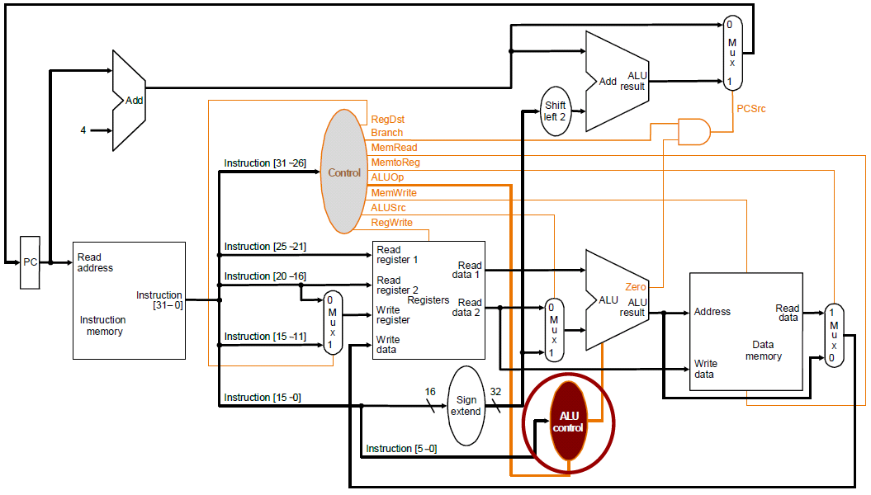
ALU Control

Slide 5
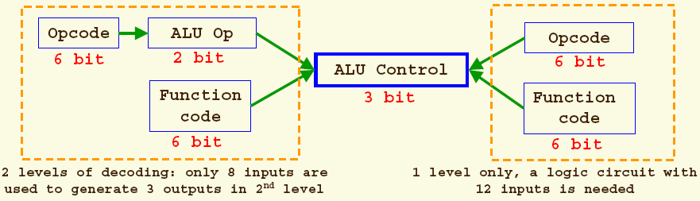
Generation of ALU Control Input Bits
Two common implementation techniques:
1-level decoding:
- more input bits.
2-level decoding:
+ less input bits, less complicated → potentially faster logic

Slide 6
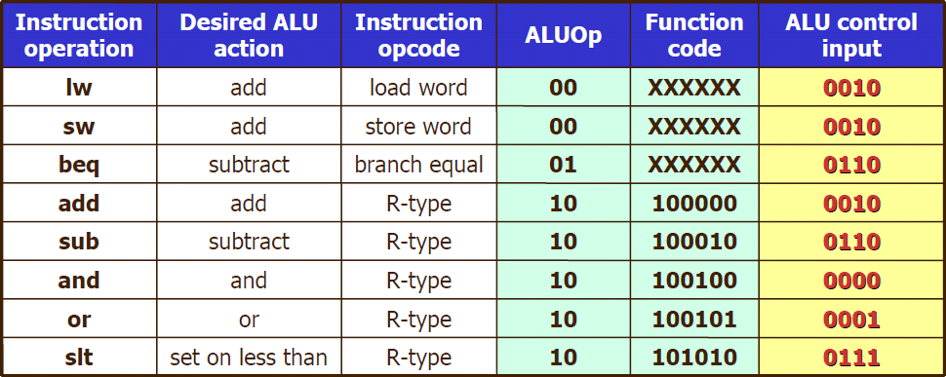
ALU Control Input Bits
Inputs used by control unit to generate ALU control input bits:
ALUOp (2 bits)
Function code of instruction (6 bits)

Slide 7
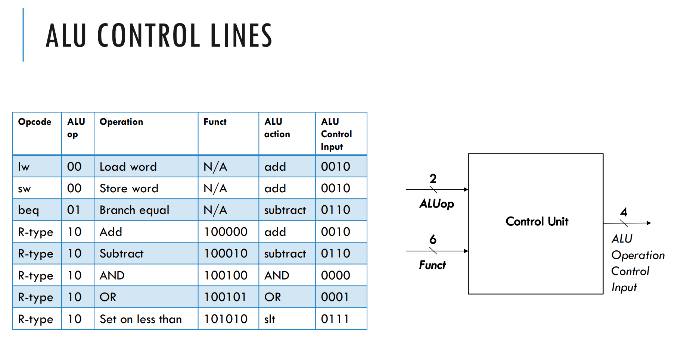

Slide 8
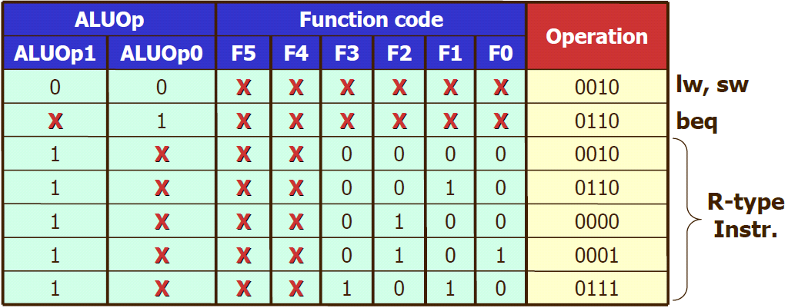
Implementing ALU Control Block
Start from truth table
Smart design converts many entries in the table to don't-care terms, leading to a simplified hardware implementation

Slide 9
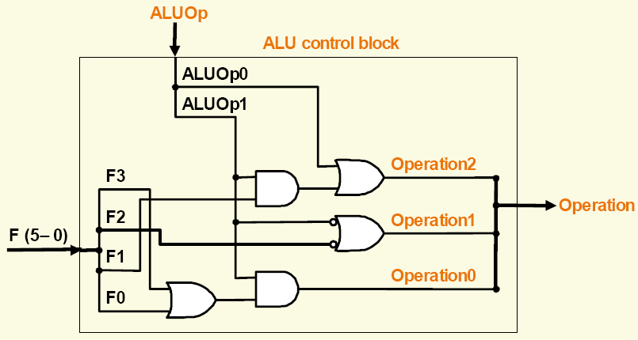
Hardware Implementation of ALU Control Block

Slide 10
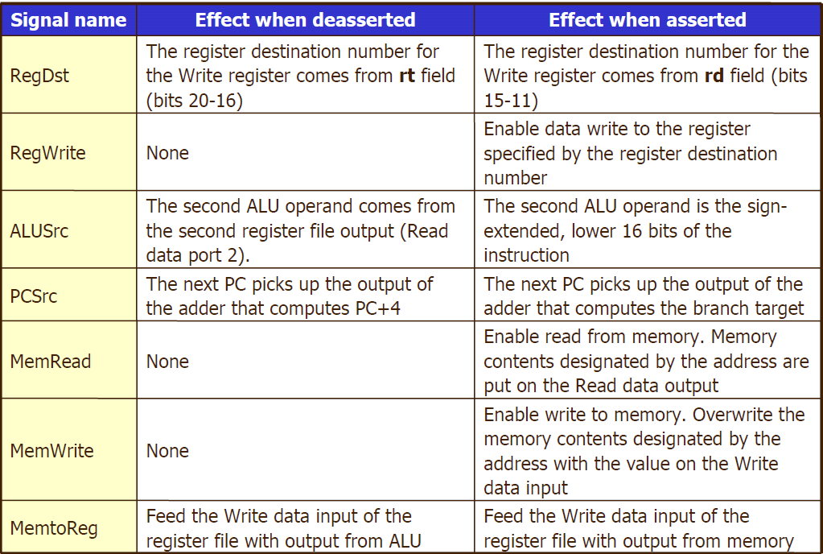
Effects of Control Signals

Slide 11
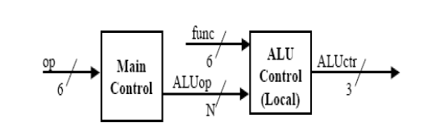
Setting of Control Signals
The 9 control signals (7 from the previous table + 2 from ALUOp) can be set based entirely on the 6-bit opcode, with the exception of PCSrc.
PCSrc control line is set if both conditions hold simultaneously:
Instruction is a branch, e.g. beq
Zero output of ALU is true (i.e., two source operands are equal)

Slide 12
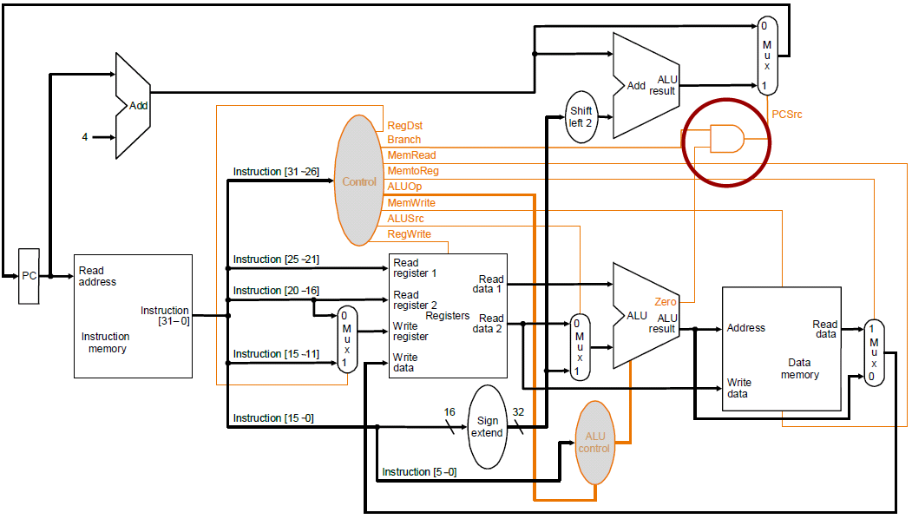
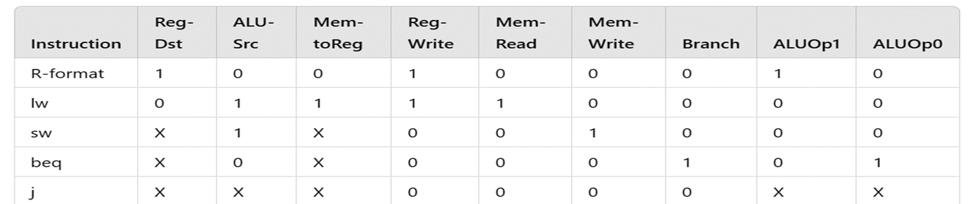
Checking the Conditions for PCSrc

Slide 13
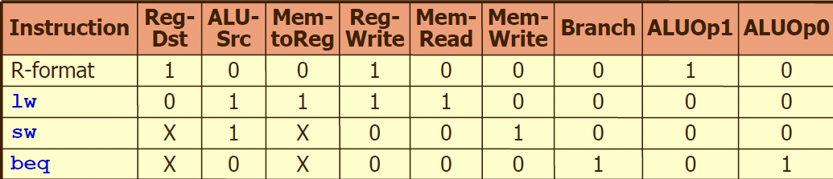
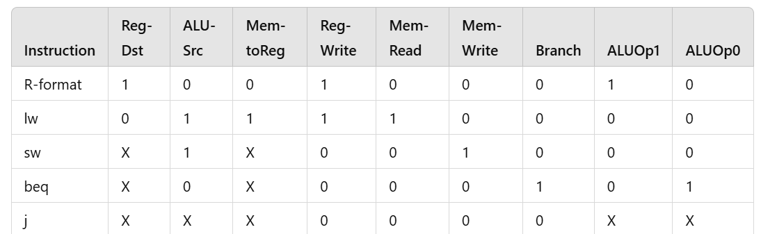
Setting of Control Signals ~
Setting of control lines (output of control unit):
sw & beq will not modify any register, it is ensured by making RegWrite to 0, So, we don’t care what write register & write data are

Slide 14
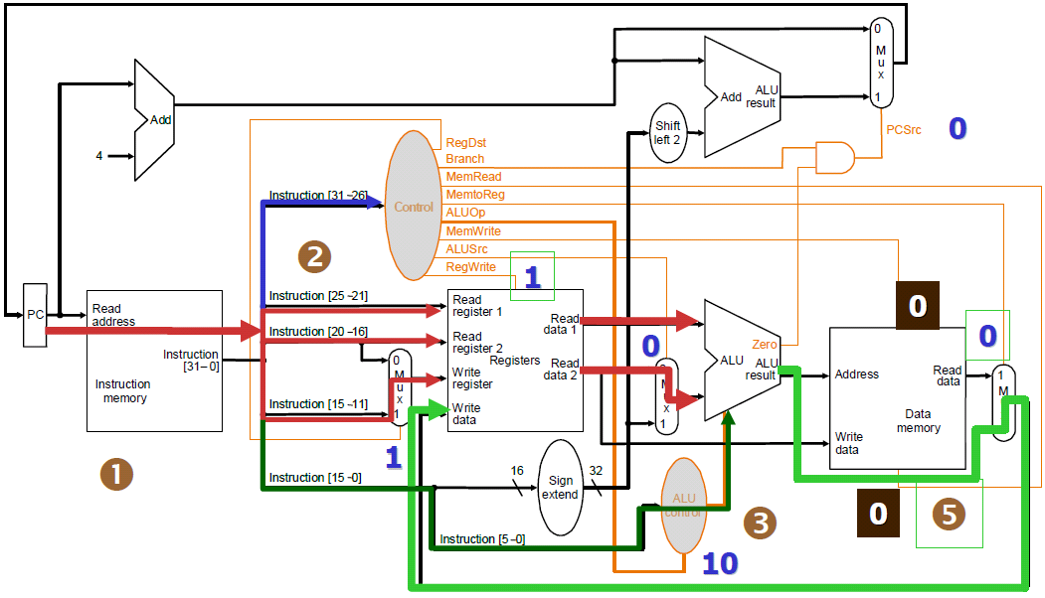
Review Datapath for R-Type Instr.

Slide 15
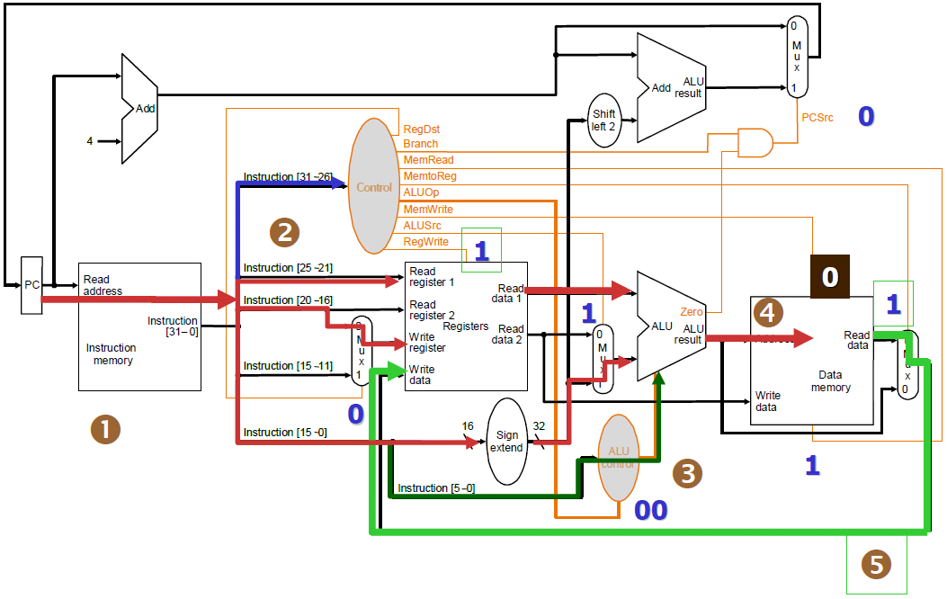
Review Datapath for Load Instr

Slide 16
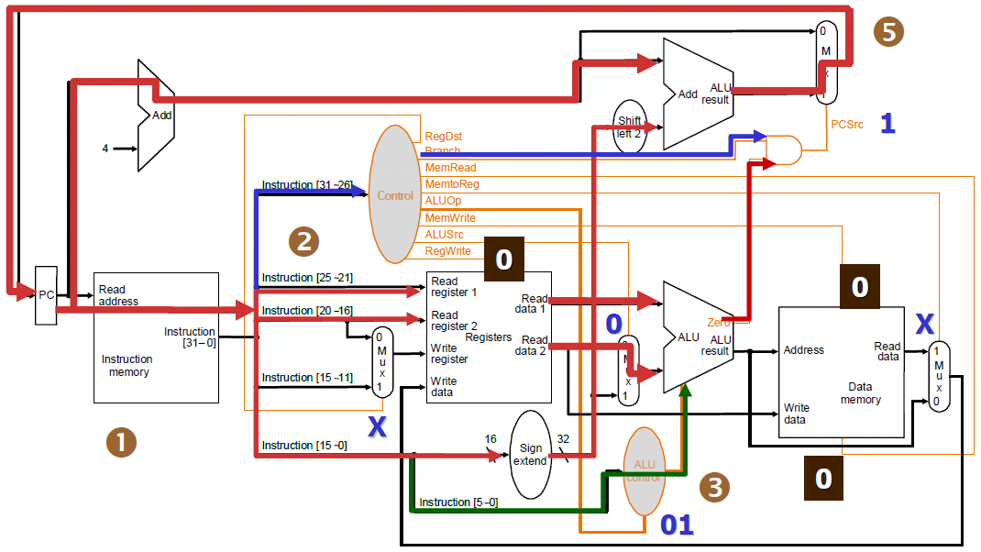
Review Datapath for Branch Instr.

Slide 17
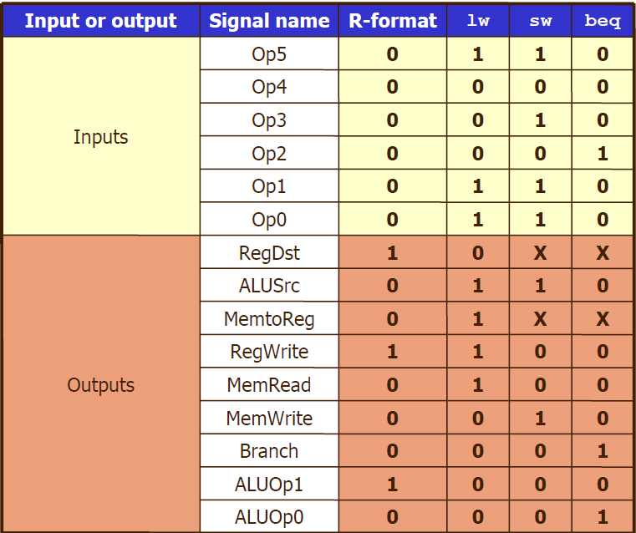
Implementing Datapath Control Unit
Start with truth table

Slide 18
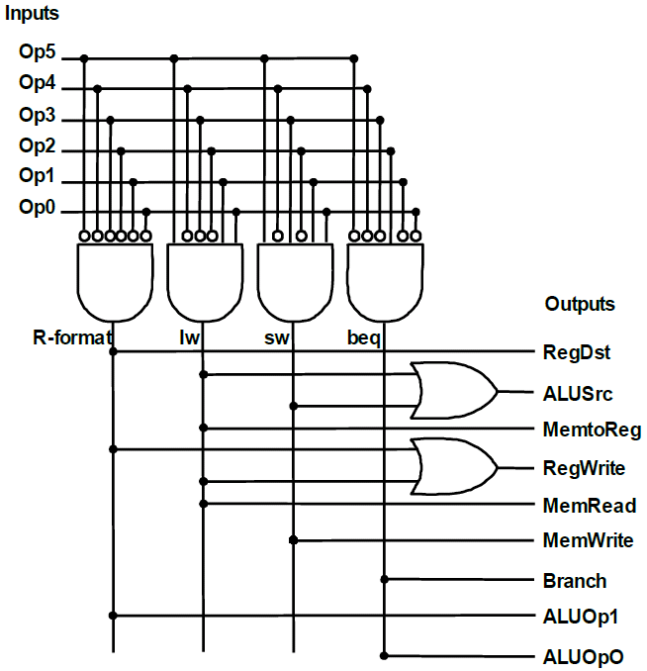
HW Implementation of Datapath Control Unit

Slide 19
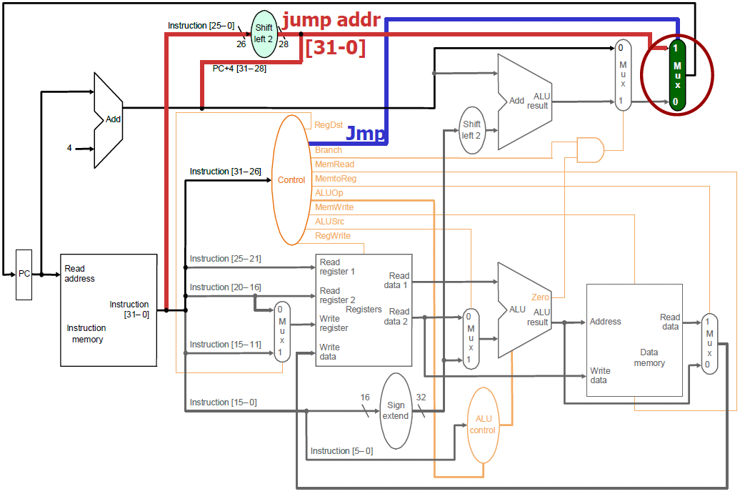
Extend Datapath & Control to Handle Jump Instr

Slide 20
Problems with Single-Cycle Datapath Implementation
Single-cycle implementation cant run very fast, Why?
Every instruction takes one clock cycle (CPI = 1), and
Clock cycle is determined by the longest path in the machine
→i.e. clock cycle is expected to be large, resulting in poor performance
What we have seen so far, the longest path is for a load instruction
Load involves five functional units in series
i.e. instruction mem., register file, ALU, data mem., register file
It is more severe when considering other computational instructions
e.g. multiplication, division, and floating-point operations, etc.
Other issues
Sharing of hardware functional units is NOT possible within a cycle

Slide 21
Can We Adopt Variable Clock Implementation?
Motivation:
Many instructions do not involve all five functions units
Question:
Why don’t vary the clock for instructions with shorter execution time?
Answer:
A variable-speed clock is very difficult to implement in hardware
The better solution:
Consider a shorter clock cycle shorter cycle and allow different types of instructions to take different numbers of clock cycles

Slide 22
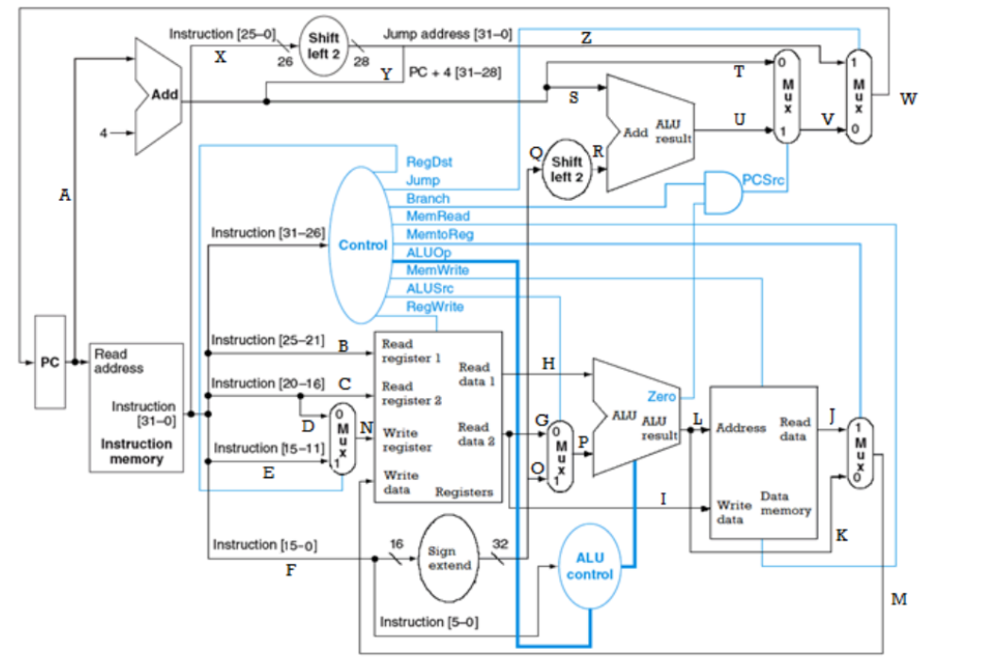
Exercise: Consider the following MIPS single cycle processor, and the snapshot of the instruction memory, data memory, and the register file. Task: Execute the instructions and fill the following table , assuming that the PC register contains 0x00400004

Slide 23
Instruction Memory
Address | Contents | Instruction
0x00400000 | 0x0253A825 | OR $S5, $S2, $S3
0x00400004 | 0x02309020 | ADD $S2, $S1, $S0
0x00400008 | 0x12530001 | BEQ $S2, $S3, 1
0x0040000C | 0x8E93FFFE | LW $S3, -2($S4)
0x00400010 | 0x08100001 | J 0x100001
Register File
Register | Data
$S0 (16) | 0x0000000A
$S1 (17) | 0x00000001
$S2 (18) | 0x02EA0160
$S3 (19) | 0x00000011
$S4 (20) | 0x00000006
$S5 (21) | 0x00123004
Data Memory
Address | Data
0x00020002 | 0x13
0x00020003 | 0x2E
0x00020004 | 0xA4
0x00020005 | 0xFF
0x00020006 | 0x08
0x00020007 | 0x2C

Slide 24
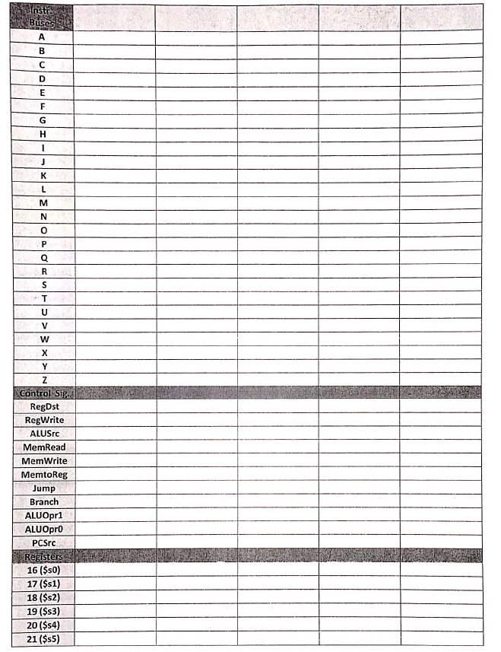

Slide 25
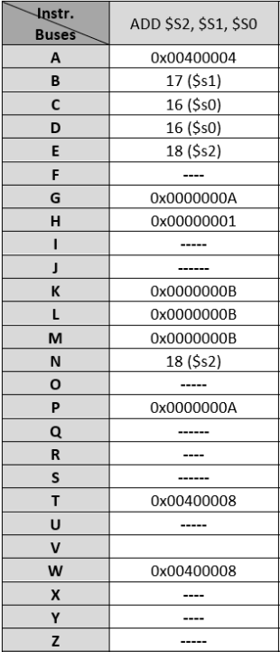
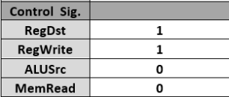
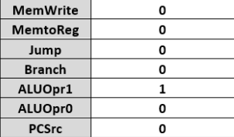
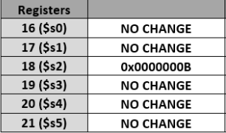

Slide 26
Multicycle Datapath and control

Slide 27
Multicycle Implementation
What does it mean by Multicycle?
An instruction takes multiple cycles to execute
Execution of each instruction is broken into a series of steps
1. Fetch the instruction
2. Decode instruction & read the registers
3. Perform ALU operation
4. Memory access (if necessary)
5. Write back the result
Each step takes equal amount of time (one cycle) to complete

Slide 28
Why Multicycle?
Key advantage:
Different types of instructions can have different number of cycles
Short instructions can complete early
e.g. R-type instruction can execute in 4 cycles instead of 5
→ Better performance as compared to the single-cycle implementation
Other advantage:
Better sharing of function units → less hardware → cheaper
→ A single functional unit can be used more than once per instruction (as long as it is used at different clock cycles)
e.g. a single memory unit is used for both instructions and data
e.g. need only a single ALU, rather than one ALU and two adders

Slide 29
Trade-off
As compared to single-cycle implementation, multicycle approach needs
A) more temporary storage to hold values between clocks.
i.e. one or more registers added after every major functional unit
Instruction registers (IR)
Memory data registers (MDR)
Registers A & B
ALUOut
B) More complex control
Multiplexors
Control signals
Question: Worth adding all these?!

Slide 30
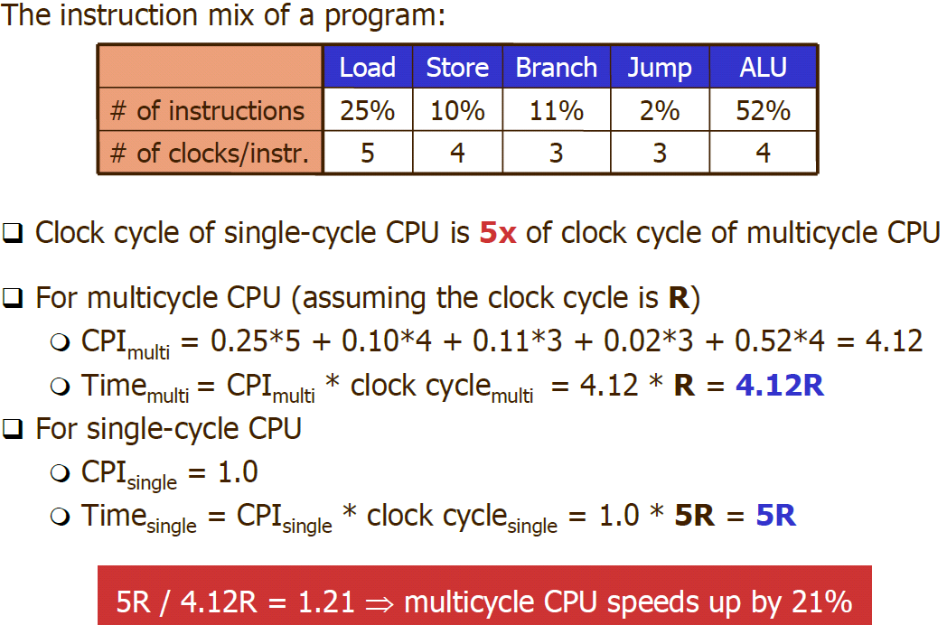
Example: Single-Cycle CPU vs. Multicycle CPU

Slide 31
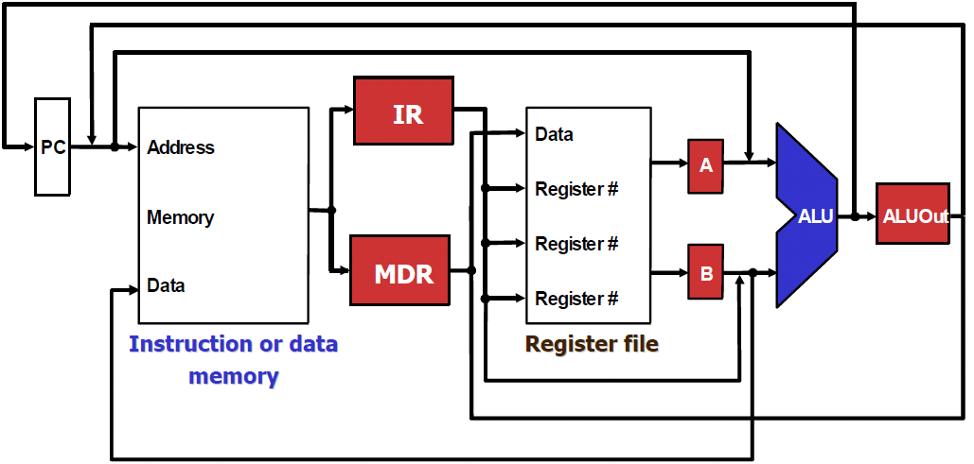
Overview of the Multicycle Datapath
IR: Instruction Register; to hold instruction from memory
MDR: Memory Data Register; to hold data from memory
A, B: registers to hold operand values from register file
ALUOut: register to hold the output of the ALU

Slide 32
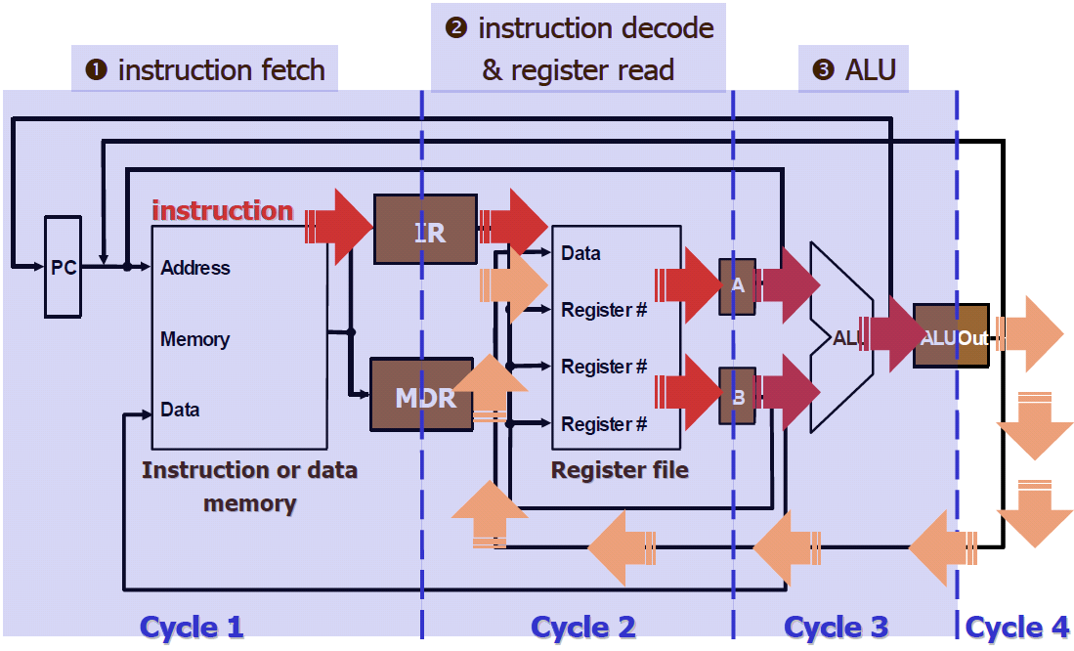
Overview: How Do These Buffer Work?
Let’s use R-type instruction as an example

Slide 33
More About Temporary Storage
Memory is connected to both IR and MDR
Output of the memory goes to both of them at the same time
It seems like
Instruction read will destroy the value stored in MDR, or
Data read will destroy the instruction stored in IR
ALUOut
Holds the ALU’s output (which will serve as an input for next cycle)
The ALU’s output can be either
Data (to be written to register or memory), or
Branch or jump target address

Slide 34
Need for Additional Control Signals
All except IR hold data only between a pair of adjacent clock cycles
→Thus, MDR, A, B, ALUOut do not need a write control signal
IR needs to hold the instruction until the end of instruction execution
→Thus, it requires a write control signal
Since several functional units are shared for different purposes,
→Multiplexors have to be added or expanded
→Thus, additional control signals are needed
See next couple slides

Slide 35
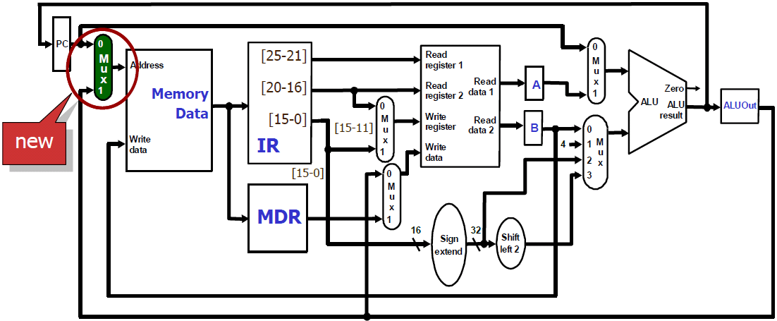
Multiplexing Addresses to Read the Memory
Memory is shared by both instructions and data
The address to the memory module is no longer just PC
It can be either instruction address (PC) or data address
→ a multiplexor is needed to choose the source

Slide 36
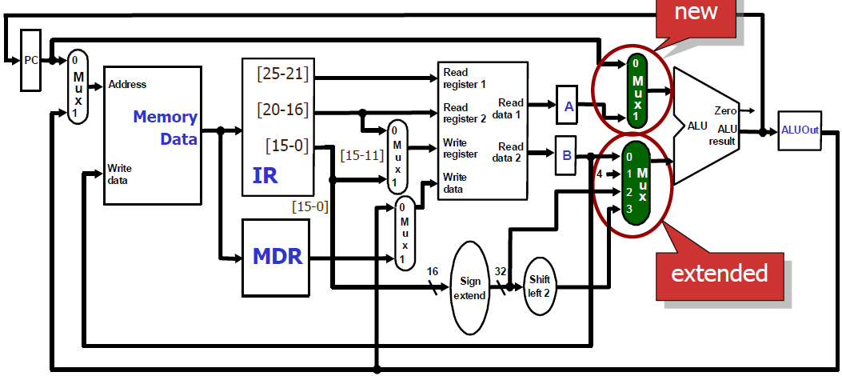
Computation of Next PC Using the ALU
The adders to compute next PC in single-cycle approach are removed, So, generation of next PC and execution of operation share the ALU
→The first source to the ALU can be either A or PC
→The second source to the ALU can be either B, sign sign-extended imm, 4, or imm shifted left 2

Slide 37
Constraints for Multicycle datapath
Only ONE ALU operation can be performed at each cycle
Will calculation of next PC conflict with other ALU operation?
If yes, what should we do then?
If no, why?
Only ONE register file access can be performed at each cycle
Will read from registers conflict with write to register?
If yes, what should we do then?
If no, why?

Slide 38
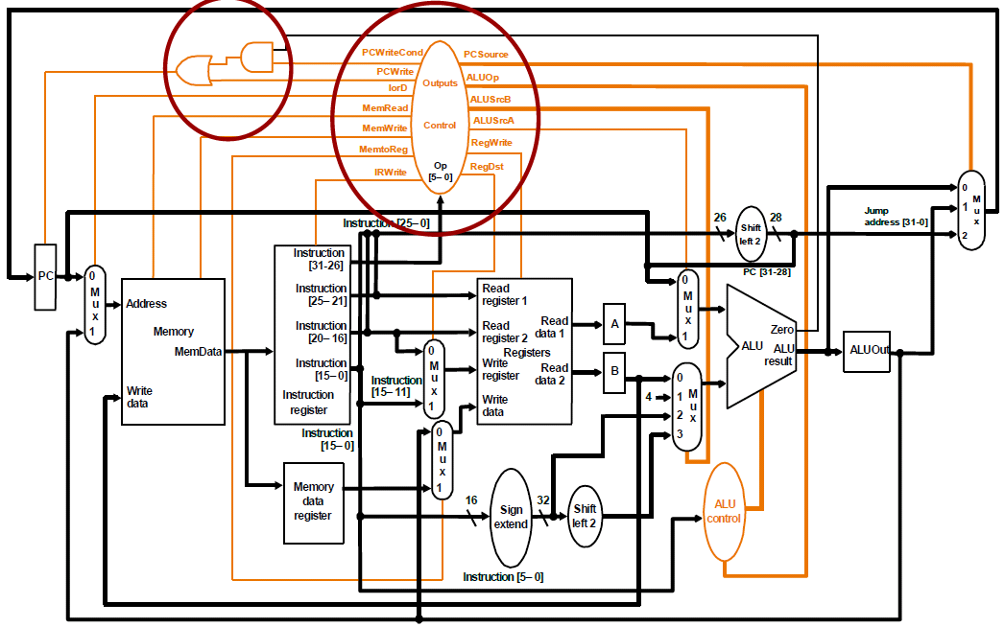
Datapath & Control for Multicycle Implementation

Slide 39
Multiple Execution Steps Per Instruction
Typical execution steps:
Instruction fetch
Instruction decode and register fetch
Execution, memory address computation, or branch completion
Memory access or R-type instruction completion
Memory read completion
Each instruction takes a few (3-5) steps.

Slide 40
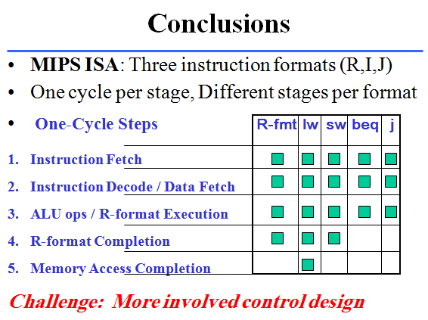

Slide 41
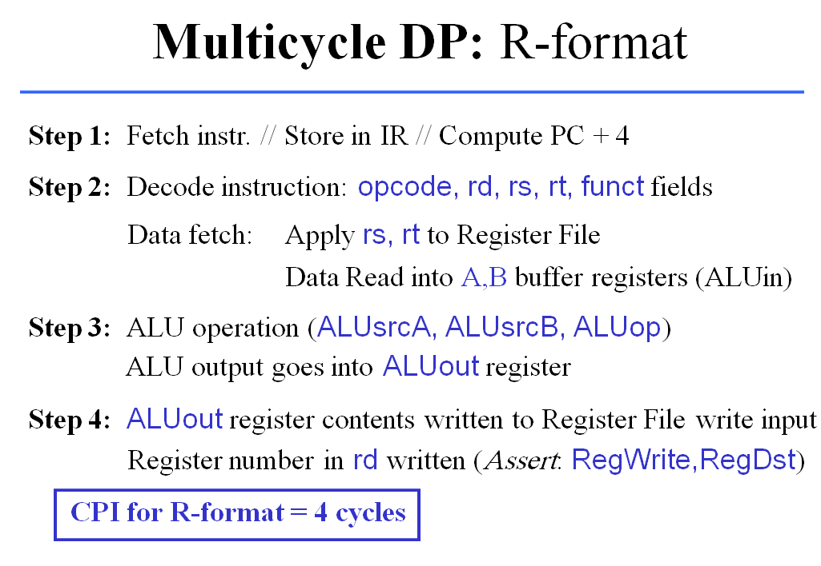

Slide 42
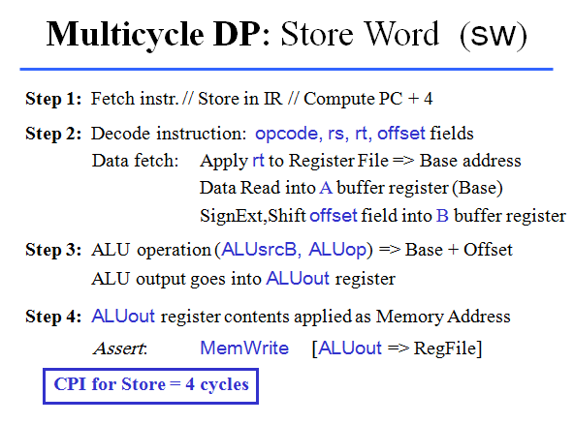

Slide 43
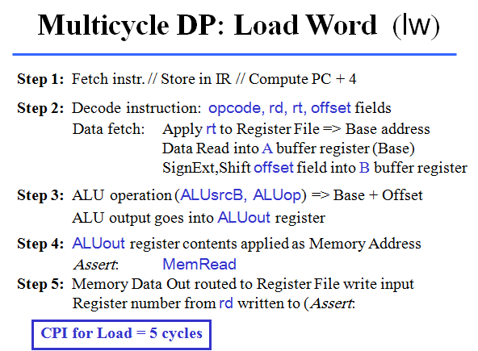

Slide 44
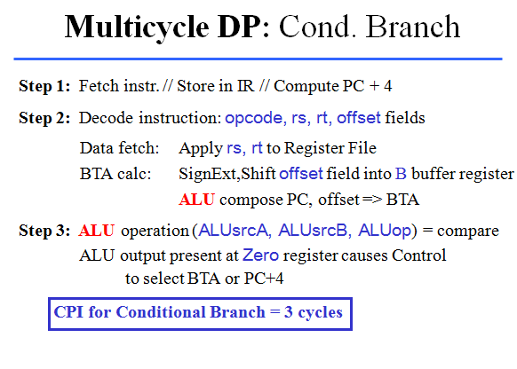

Slide 45
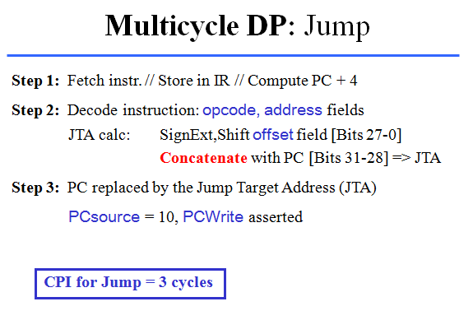

Slide 46
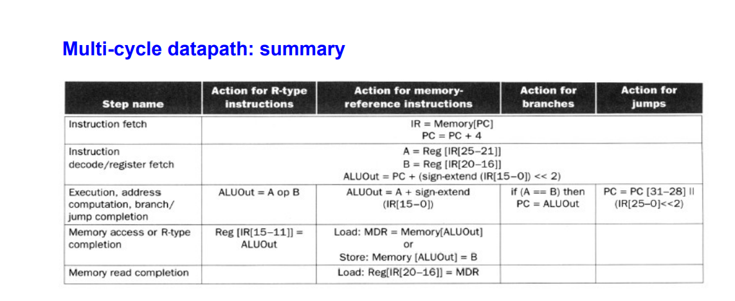

Slide 47
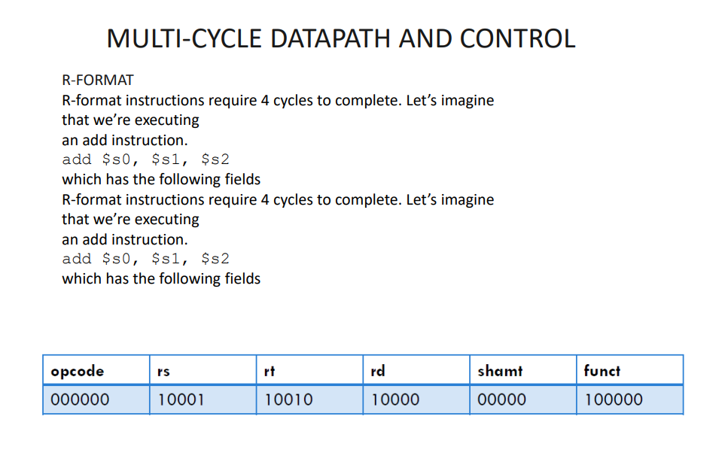

Slide 48
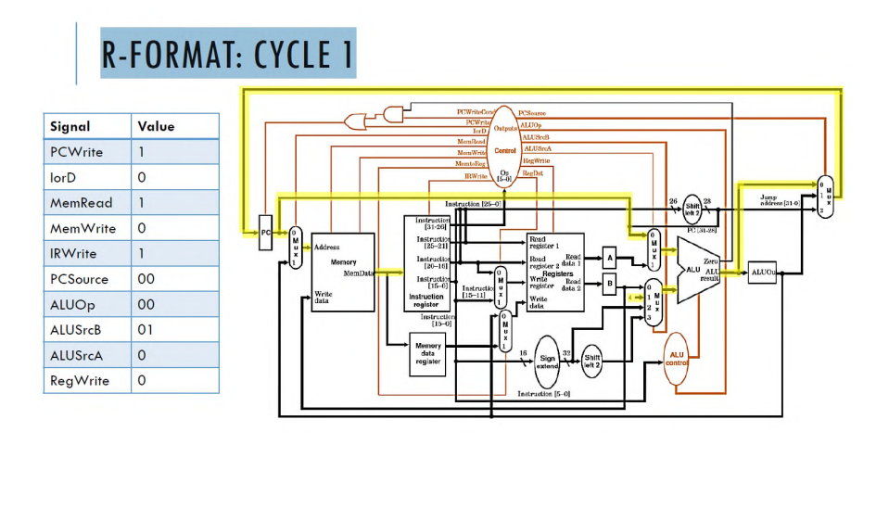
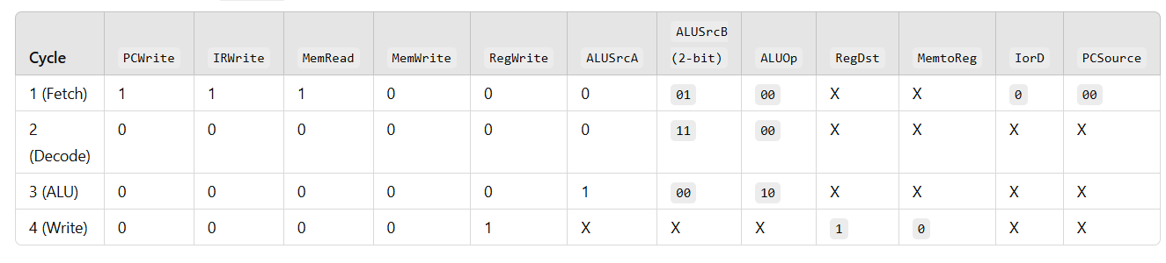

Slide 49
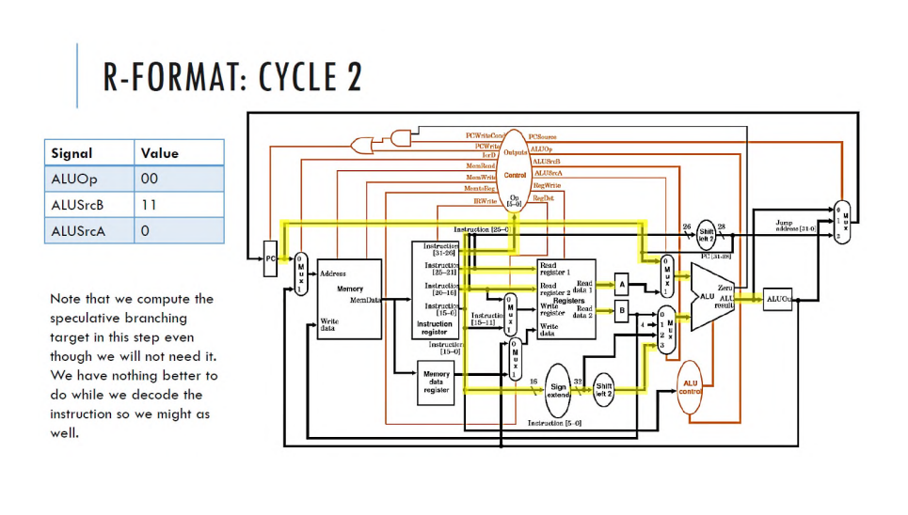

Slide 50
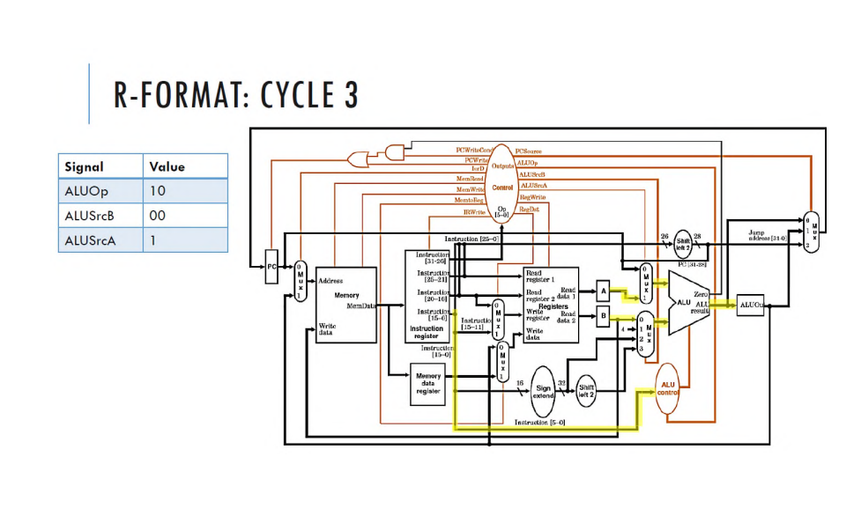

Slide 51
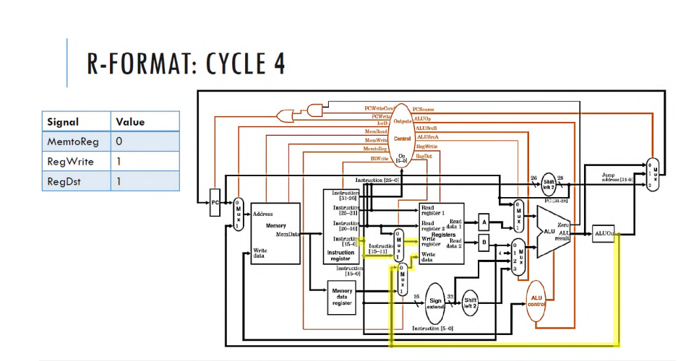

Slide 52
Example Control line for add instruction for each step

Slide 53
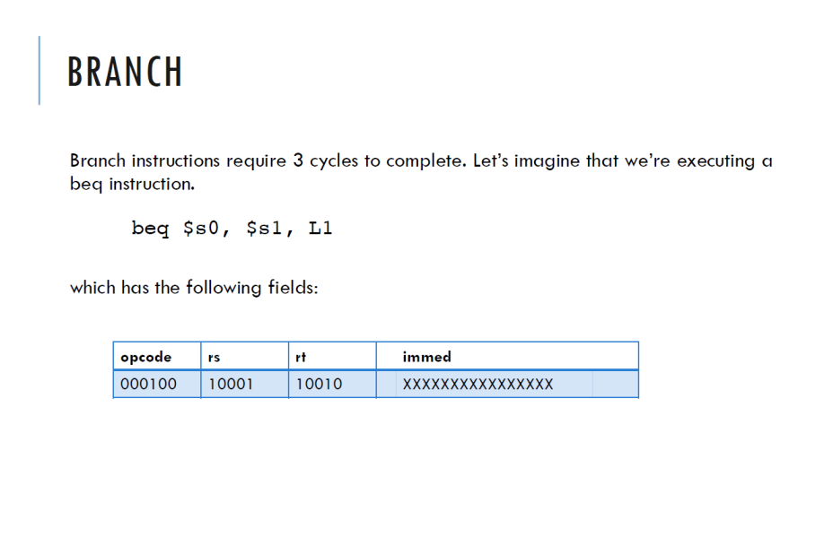

Slide 54
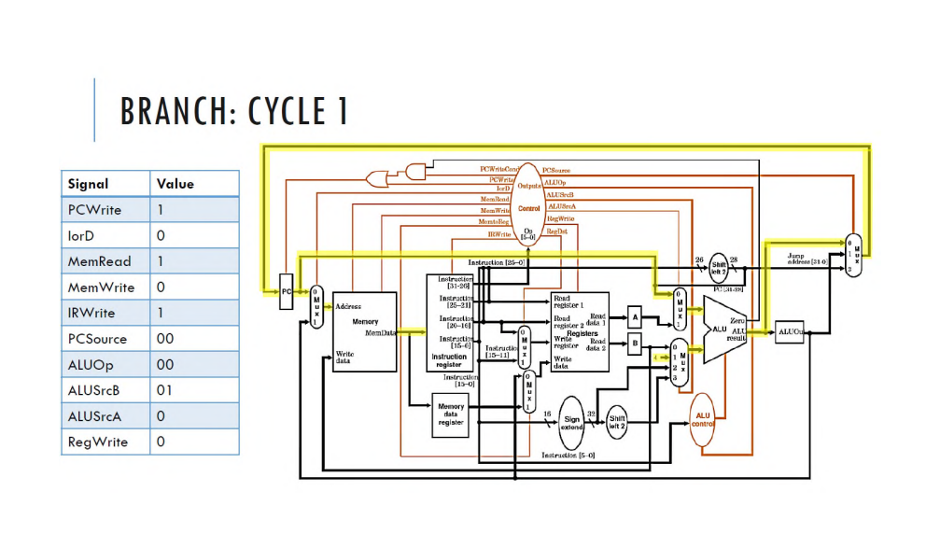

Slide 55
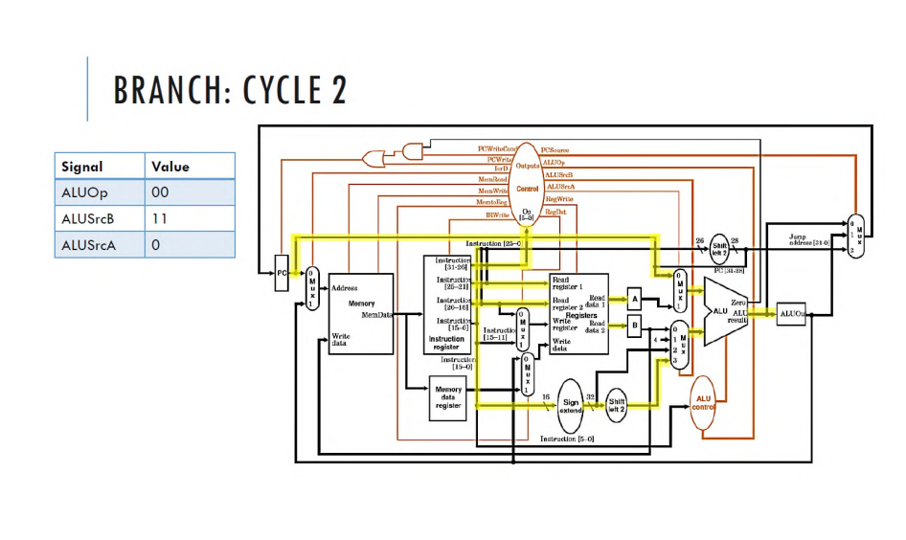

Slide 56
